Slide 1
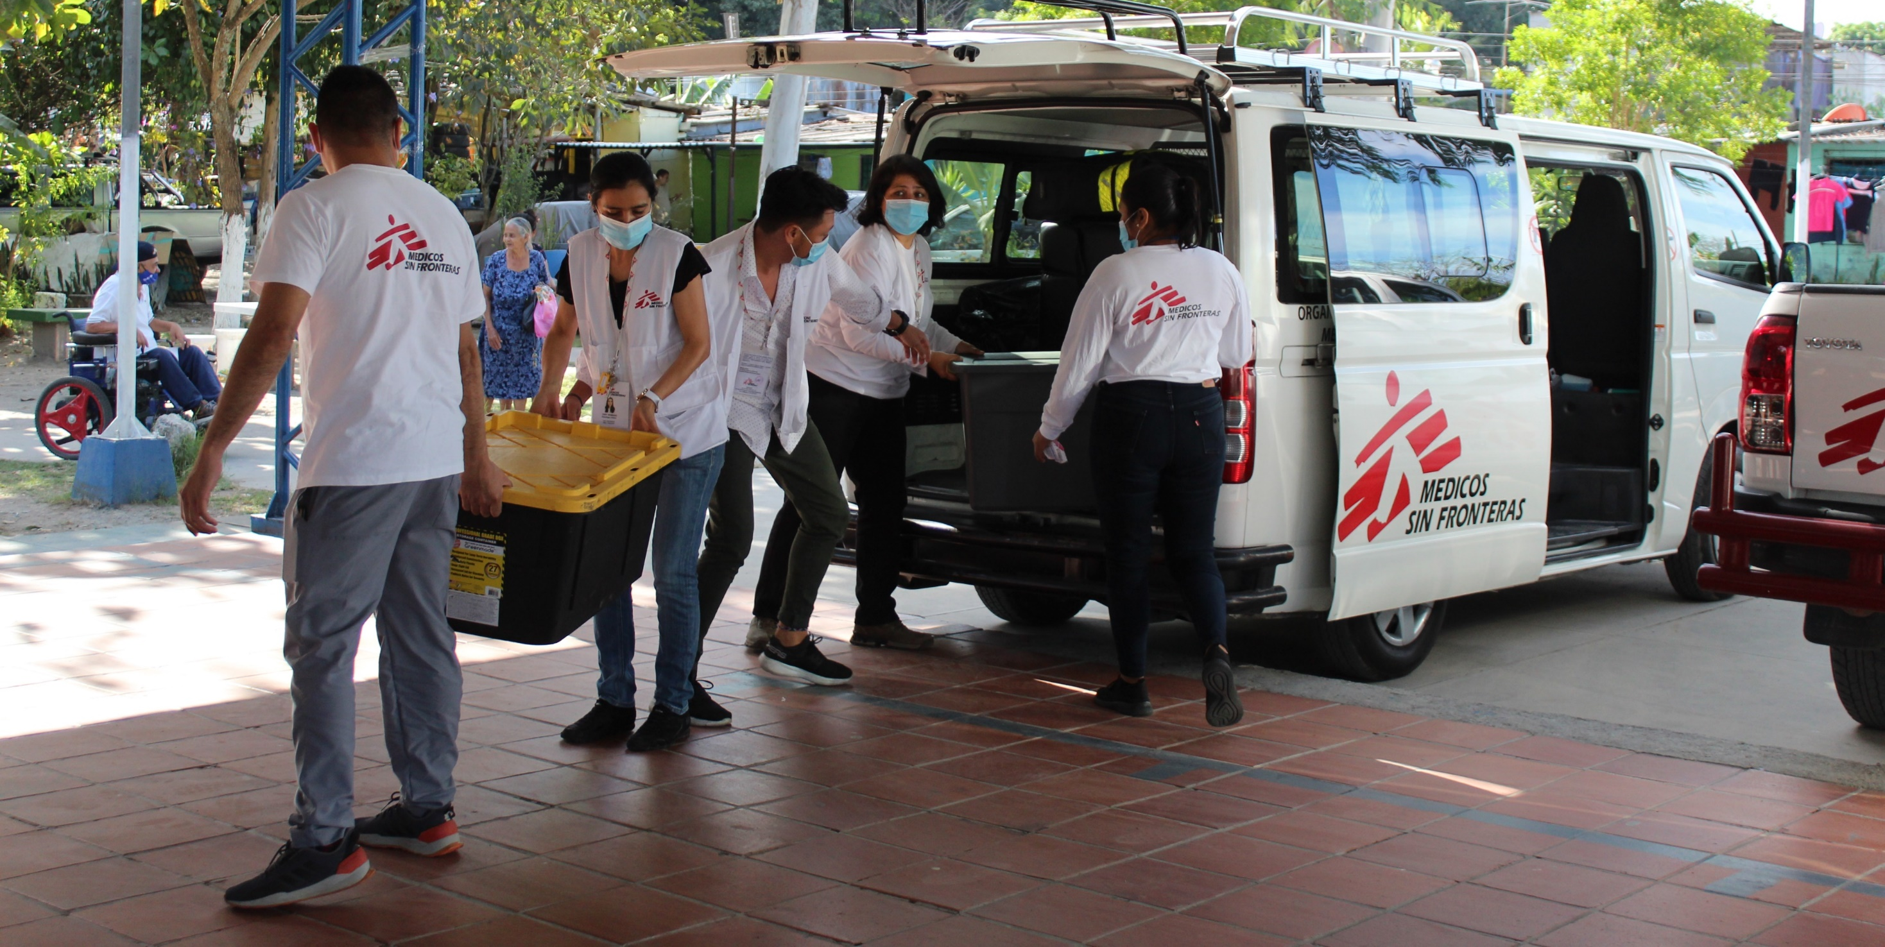
AC HR Transition Plan
June 2024

Slide 2
Today’s purpose and scope
This session’s purpose is to present you with the AC HR Transition Plan, as part of the APH model change process.
The session will cover:
The process for developing the plan (incl. how and why this was adjusted in early 2024)
The objectives of the plan
The key elements of this plan
The plan and other supporting/relevant materials will be made available to you after this presentation.
This session includes substantial time for questions.
We acknowledge that this announcement comes later than was previously communicated but we are confident that the extra time has allowed us to develop a more complete and better thought-out plan.

Slide 3
Introduction
Over the last 6 months the OMC has focused on defining a plan for transitioning the Access Campaign’s unique capacities, networks and initiatives to the new APH Structure for the start of its operations in January 2025.
The presentation today, will explain the details of this plan and how we got there: critical assumptions and how they have developed over the last period.
From January 2025 the new APH Structure will take over APH initiatives currently managed by the Access Campaign (AC) that are consistent with MSF’s new APH Common Priorities.
Consequently, the APH Structure will replace the AC from January 2025.

Slide 4
Topics
Introduction
Recent developments and background
Objectives, consultations and approach
Key elements of the AC HR Transition plan
Next steps
Q&A

Slide 5
Objectives, new planning assumptions and adaptation
The AC HR Transition objectives are to:
Ensure the timely and effective recruitment of APH staff for the new APH Model.
Preserve APH capacity, networks and initiatives [as much as possible].
It was originally planned that the definition of the core functions of the APH Structure be finalised at the end of this year and the full organisation chart be completed by June 2025.
In April, the first elements of information on APH Common Priorities emerged, as well as better visibility on the timeline for appointment of the APH Structure MT.
It is now expected that the APH Structure Strategic Plan will only be completed at the end of Q3 2025 and the APH Structure's full staffing plan will also only be finalised then.
Therefore, the APH Structure will have an annual plan for 2025, pending the development and approval of its Strategic Plan for 2026.

Slide 6
Objectives, new planning assumptions and adaptation - cted
The AC and the APH Structure could not run concomitantly as:
they require, in part, a number of similar resources and capacities.
This would generate complexity and confusion in relation to accountability for MSF’s collective APH work.
It would further extend the uncertainty for AC staff concerned.
It would create duplications in financial costs at the expense of other social mission priorities
Therefore, the OMC has focused on designing a plan for preserving AC unique capacities that can be integrated within, but “delinked” from, the APH Structure decisions on its final organigramme and staffing plan.

Slide 7
Topics
Introduction
Recent developments and background
Objectives, consultations and approach
Key elements of the AC HR Transition plan
Next steps
Q&A

Slide 8
Objectives of the AC HR Transition Plan
Define functions and expertise to be transitioned from the AC to the APH Structure, so that:
Key capacities, which the APH Structure will require going forward, are preserved.
Key external networks for partnering and effecting change are safeguarded
Relevant current AC initiatives are continued into 2025.
Define provisions for the AC staff transitioned into the APH Structure that would need to relocate
Define provisions for those AC staff that may not be transitioned into the APH Structure

Slide 9
Approach and constraints
It has been our intent throughout the design of this process to treat all employees as equitably as possible:
with respect to each other,
with respect to other colleagues in the sections/offices in which they are hosted.
In developing this plan, we have considered the different legal and regulatory requirements of the 11 jurisdictions in which AC staff is based.
In addition to very differing legal landscapes, we had to respect the autonomy of each MSF office in applying its own policies and rules.
The proposed plan is as consistent and aligned as possible given the above constraints.

Slide 10
Consultations and design timeline
(October-December): Scoped the work and initial consultations conducted with HR and legal specialists.
(December): Start of main consultations and design work by OMC sub working group (Andreu, Jeremie, Joan, Renata, Sid), supported by HR, EDI and Legal.
(January): first round of consultations with the 11 Sections/offices hosting AC staff.
(31 January): Letter from AC staff received.
(16 April): Discussion with the ISC.
(22 April – 16 May): First plan drafted, authorised by OMC and SG for further consultations
(16 – 30 May) second draft consultation of the 11 Sections/offices hosting AC staff
(3 – 13 June) Final plan drafted, approved by the OMC and authorised for release by the SG
(17 June): Plan presented to the ISC

Slide 11
Topics
Introduction
Recent developments and background
Objectives, consultations and approach
Key elements of the AC HR Transition plan
Next steps
Q&A

Slide 12
Key elements of the AC Transition Plan
The AC HR Transition Plan defines:
Opening of positions in the APH Structure exclusively for AC staff in 2024
A timeframe for the proposed relocation of AC staff that is selected for transition into the APH Structure.
A package of professional support and coaching for all AC staff.
A severance package for all AC staff that are not offered/do not accept a position in the new APH Structure.
A timeframe for the handover of the AC work and assets into the APH Structure and/or the rest of the Movement.
Notes:
That successful candidates (appointees??) are expected to relocate within 2 years to Regional Hub or Strategic Location defined by the APH Structure and announced no later than end of September 2025
That during this two years period appointees that prefer not to relocate provide a 6 months notice* to the APH Structure, with three being served with no obligation to work.

Slide 13
Key elements of the AC HR Transition plan
Positions opened for exclusive recruitment in the AC and relocation
Professional support and coaching
Transition and severance package
Handover of AC work

Slide 14
Positions opened to the AC for exclusive recruitment
Exclusive recruitment to AC staff
17 APH Structure positions will be opened exclusively to the AC at the end of June.
The interviews will be carried out by panels that will include an APH Structure staff and an HR professional.
All recruitments will be completed before the end of September 2024.
A dedicated session to provide more detailed information on the recruitment process will be set-up for the 20th of June
Notes:
That successful candidates (appointees??) are expected to relocate within 2 years to Regional Hub or Strategic Location defined by the APH Structure and announced no later than end of September 2025
That during this two years period appointees that prefer not to relocate provide a 6 months notice* to the APH Structure, with three being served with no obligation to work.

Slide 15
Positions opened to the AC for exclusive recruitment
Relocation
The locations of these positions will be defined by the APH Structure (likely to be a Regional Hub) by October 2025.
Staff recruited into the APH Structure will have time to relocate until September 2026.
Once locations are defined, staff that have been recruited into the APH Structure will still be eligible for the equivalent of the full transition and severance package, if they chose to leave.
Notes:
That successful candidates (appointees??) are expected to relocate within 2 years to Regional Hub or Strategic Location defined by the APH Structure and announced by October 2025
That during this two years period appointees that prefer not to relocate provide a 6 months notice* to the APH Structure, with three being served with no obligation to work.

Slide 16
Positions opened for exclusive recruitment to the AC staff 1/2
The definition and design of the functions and requirements of the 17 positions has been guided by:
The APH Common Priorities selected by the MedOp
The responsibilities of the APH Structure departments & regional hubs defined in the APH Model.
The choice of Regional Hubs approved by the Full ExCom.
The International Board approved overall Principles for the Change Plan.
The assessment of existing competences and expertise in the AC.

Slide 17
Positions opened for exclusive recruitment to the AC staff 2/2
The OMC:
qualified functions and expertise in the AC most relevant and aligned with Common Priorities supported by 3 or more ODs
estimated the level of capacity and expertise necessary to:
Ensure the transition end of 2024 the AC initiatives aligned with Common Priorities.
Eensure the initial support for the delivery of the APH Structure in 2025 [including contribution to the development of the APH Structure Strategic Plan].
The 17 positions can be grouped in 4 categories:
Common Priorities related medical analysis
Advocacy strategies design, implementation and support
Transversal analysis and support
Regional expertise and networks

Slide 18
Positions opened exclusively for AC staff in the APH Structure
Common Priorities related medical analysis
NCD medical advisor
Vaccine medical advisor ​
TB/AMR medical advisor ​
Diagnostic medical advisor
Regional expertise and Networks
Regional advisor – Africa
Regional advisor – Asia
Regional advisor – Asia
Regional advisor – Americas
Regional advisor – Europe ​
Advocacy strategies design, implementation & support
General advocacy advisor
General advocacy advisor​
General advocacy advisor
Strategic comms advisor
Strategic comms advisor
Digital comms
Transversal analysis and support
Pharmacist
Pharmacist

Slide 19
Key elements of the AC HR Transition plan
Positions opened for exclusive recruitment in AC and relocation
Professional support and coaching
Transition and severance package
Handover of AC work

Slide 20
Professional support and coaching
All staff will be offered “outplacement support” between June and December 2024, consisting of:
interview training
CV drafting
Professional reorientation coaching

Slide 21
Key elements of the AC HR Transition plan
Positions opened for exclusive recruitment in AC and relocation
Professional support and coaching
Transition and severance package
Handover of AC work

Slide 22
Transition and severance package
Staff who are not offered/do not accept a role in the APH Structure (or anywhere else within the movement) at the end of September will be provided formal notice on the 1st of October.
Their contract will continue and they will remain on the payroll until the 31st of December, with the option of being released from their obligations to work during this period. Full severance payment will be provided at the end of this period.
Staff who do not wish to apply to APH Structure positions will also benefit from these provisions.
MSF severance policies of the relevant hosting office will apply, with the exception of a small number of countries where provisions will be increased to bring them to line with the rest.
The OMC sought to ensure as much equality as possible in support provided across the AC staff contracted across in 11 different Sections and offices, whilst ensuring those provisions were acceptable to those offices / not creating inequalities in treatment of other MSF staff there.

Slide 23
Key elements of the AC HR Transition plan
Positions opened for exclusive recruitment in AC and relocation
Professional support and coaching
Transition and severance package
Handover of AC work

Slide 24
Handover of the AC work
From July, the AC portfolio and “BAU” workstreams will be reviewed to identify workstreams and initiatives that are not fully aligned with Common priorities.
Those initiatives will then be transferred to Sections, ODs or the International Office, or phased out by the end of September 2024.
Between September and December 2024, the APH Structure and the AC will work together to frame initiatives aligned to the Common Priorities to be transferred to the APH Structure and continue into 2025.
Those initiatives will run under the responsibility of the AC until the end of December 2024.
The APH Structure will take over steer and management from the 1st of January 2025.
Practically, the AC will stop operating at the end of December 2024.
From July onwards, a practical AC closure plan will be designed and implemented with regards to:
External communication on the transition
Assets and external parties’ contracts transfer or termination
Data and information management
Digital footprint

Slide 25
Recap
The AC HR Transition Plan defines:
17 positions that will be opened in the APH Structure exclusively for AC staff in 2024
For AC staff not wanting or offered a role in the APH Structure by September 2024: a transition and severance package including three months under contract with no obligation to work
The same package provided for AC staff offered a role in the APH Structure before September 2024, but who would decide to leave the APH Structure before September 2026.
Professional support and coaching for all AC staff offered from June
The timeframe for the handover of the AC initiatives and its closure in December 2024

Slide 26
Who to contact for support, advice and information
Personal support:
For information and support in relation to your individual contract please contact your hosting office HR.
For a discussion with a “Person of Trust” please contact aurelie.defrancesco@personne-de-confiance.com.
Psychosocial support is available through your contracting/hosting office.
For other personal question or request for support, if you are not sure who to ask please contact Ioana Chartier or HR.IO@geneva.msf.org.
Outplacement and reorientation support:
For information on Outplacement support, please contact Akiko Kojima akiko.hrm@gmail.com
For Professional Reorientation support, please ask Ioana Chartier to put you in touch with Nancy Bonami
General information:
For a complaints about this process please contact the MSF International Staff Committee who will relay them to the responsible bodies or individuals
If you have questions of clarifications on the plan or its implementation and are not sure who to contact, please write to APH-Transition.IO@geneva.msf.org and the OMC and or IO HR answer as promptly as possible.

Slide 27
Topics
Introduction
Recent developments and background
Objectives, consultations and approach
Key elements of the AC HR Transition plan
Next steps
Q&A

Slide 28
Next steps
AC staff transition
20th of June – AC exclusive positions recruitment information session
24th of June – AC exclusive positions opened
September – Completion of recruitment of AC exclusive positions
October-December – AC staff not transitioned serve notice with no obligation to work
Transition of initiatives
July – September – planning for handover of “non Common Priorities” initiatives
December – Final handover of AC portfolio to APH Structure and other relevant MSF entities.
January - AC recruited “exclusive positions” reports to APH Structure.
Notes:
That successful candidates (appointees??) are expected to relocate within 2 years to Regional Hub or Strategic Location defined by the APH Structure and announced no later than end of September 2025
That during this two years period appointees that prefer not to relocate provide a 6 months notice* to the APH Structure, with three being served with no obligation to work.

Slide 29
Topics
Introduction
Recent developments and background
Objectives, consultations and approach
Key elements of the AC HR Transition plan
Next steps
Q&A

